Slide 1
Design and Analysis of Algorithm
UNIT-II
Greedy Algorithm
M Yogi Reddy
Assistant Professor,
Dept. of CSE,
School Of Technology,
GITAM(Deemed to be ) University,
Hyderabad.

Slide 2

Contents
Job Sequencing Algorithm
Knapsack Problem
Optimal storage on tapes [Huffman coding]
Minimum cost spanning trees
Single source shortest paths
Using Dijkstra’s Algorithm
1
2
3
4
5

Slide 3
Graph
Graphs can be used to represent the connecting structure,
e.g. road of a state or country with vertices representing cities and edges representing sections of roads. The edges can then be assigned weights which may be either the distance between the two cities or the cost of moving from one city to another
Suppose you are to attend a party and for that your friend has invited you to the famous restaurant of city. Now you are interested in following answers
If there is a path from your home to restaurant?
If more than one path available ?
Which is the shortest path?

Slide 4
Path between nodes
Consider Source node 1 and destination node 7
A direct path between Nodes 1 and 7 will cost 14
A shorter path will cost only 11

Slide 5
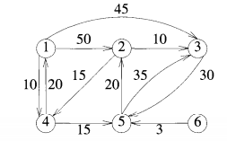
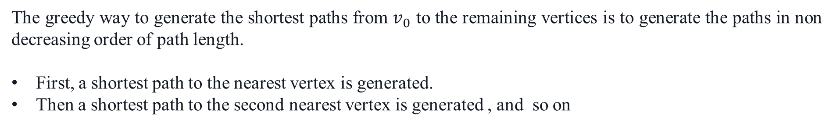
Path construction
The greedy way to generate the shortest paths from $v_{0}$ to the remaining vertices is to generate the paths in non decreasing order of path length.
First, a shortest path to the nearest vertex is generated.
Then a shortest path to the second nearest vertex is generated , and so on
Path | Length
1,4 | 10
1,4,5 | 25
1,4,5,2 | 45
1,3 | 45
The length of a path is defined to be the sum of the weights of the edges on that path. The starting vertex of the path is referred to as the $source$,and the last vertex the $destination$

Slide 6
Path construction
Let S denote the set of vertices (including $v_{0}$) to which the shortest paths have already been generated. For w not in S, let dist [w] be the length of the shortest path Starting from $v_{o}$, going through only those vertices that are in S, and ending at w.

Slide 7
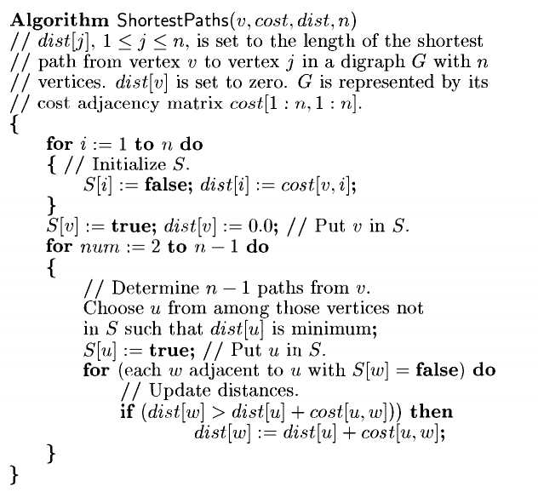

Algorithm
$$S=\left\{φ\right\}$$

Slide 8
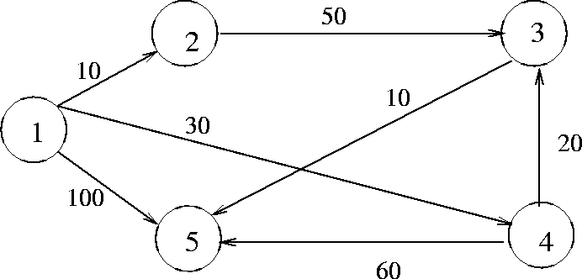
Algorithm
Initialization:$S=\left\{1\right\} D\left(2\right)=10, D\left(3\right)=∞, D\left(4\right)=30, D\left(5\right)=100$

Slide 9

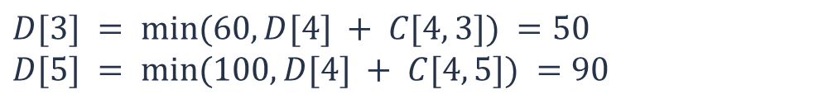

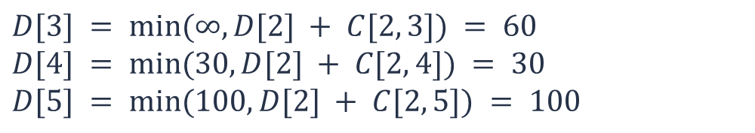

Algorithm
Select $w = 2$, so that $S = \{1, 2\}$
$D[3] = min⁡(∞, D[2] + C[2, 3]) = 60$
$D[4] = min⁡(30, D[2] + C[2, 4]) = 30$
$D[5] = min⁡(100, D[2] + C[2, 5]) = 100$
Select $w =4$, so that $S = \{1, 2, 4\}$
$D[3] = min⁡(60, D[4] + C[4, 3]) =50$
$D[5] = min⁡(100, D[4] + C[4, 5]) =90$
D[2]=10
D[4]=30
D[3]=50
D[5]=60
Select $w =3$, so that $S = \{1, 2, 4,3\}$
$D[5] = min⁡(90, D[3] + C[3, 5]) =60$

Slide 10
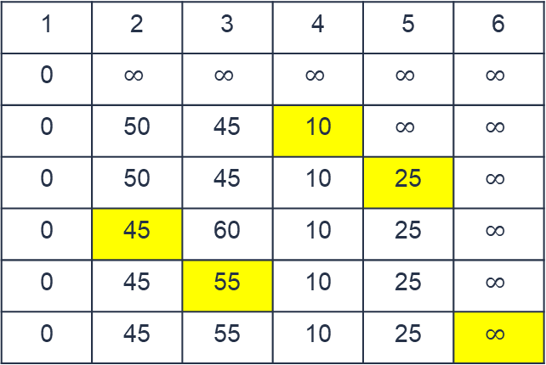
Source vertex is 1
Example
Vertex Selected
Step1 {1}
Step2 {1,4}
Step3 {1,4,5}
Step4 {1,4,5,2}
Step5 {1,4,5,2,3}
Destination: D[v]
1 | 2 | 3 | 4 | 5 | 6
0 | $$∞$$ | $$∞$$ | $$∞$$ | $$∞$$ | $$∞$$
0 | 50 | 45 | 10 | $$∞$$ | $$∞$$
0 | 50 | 45 | 10 | 25 | $$∞$$
0 | 45 | 60 | 10 | 25 | $$∞$$
0 | 45 | 55 | 10 | 25 | $$∞$$
0 | 45 | 55 | 10 | 25 | $$∞$$
Hence, the minimum distance of vertex 5 from vertex 1 is -------. And the path is -------

Slide 11
Source vertex is 6
Example(Assignment)
Vertex Selected
Destination: D[v]
1 | 2 | 3 | 4 | 5 | 6
Find the minimum distance of vertex 1 from vertex 6 ? And the path is ?

Slide 12
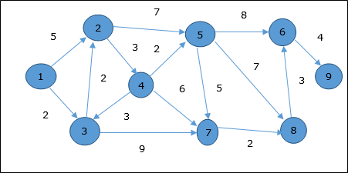
Let us consider vertex 1 and 9 as the start and destination vertex respectively. Initially, all the vertices except the start vertex are marked by ∞ and the start vertex is marked by 0.
Vertex | Initial | Step1 V₁ | Step2 V₃ | Step3 V₂ | Step4 V₄ | Step5 V₅ | Step6 V₇ | Step7 V₈ | Step8 V₆
1 | 0 | 0 | 0 | 0 | 0 | 0 | 0 | 0 | 0
2 | ∞ | 5 | 4 | 4 | 4 | 4 | 4 | 4 | 4
3 | ∞ | 2 | 2 | 2 | 2 | 2 | 2 | 2 | 2
4 | ∞ | ∞ | ∞ | 7 | 7 | 7 | 7 | 7 | 7
5 | ∞ | ∞ | ∞ | 11 | 9 | 9 | 9 | 9 | 9
6 | ∞ | ∞ | ∞ | ∞ | ∞ | 17 | 17 | 16 | 16
7 | ∞ | ∞ | 11 | 11 | 11 | 11 | 11 | 11 | 11
8 | ∞ | ∞ | ∞ | ∞ | ∞ | 16 | 13 | 13 | 13
9 | ∞ | ∞ | ∞ | ∞ | ∞ | ∞ | ∞ | ∞ | 20
Hence, the minimum distance of vertex 9 from vertex 1 is 20. And the path is 1→ 3→ 2→ 8→ 6→ 9

Slide 13
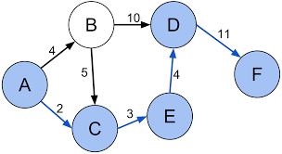
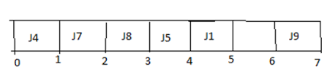
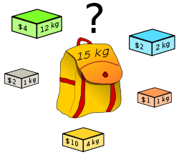
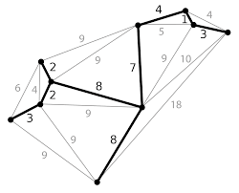
What we learnt in Greedy?
Knapsack Problem
Job sequencing with deadline
Minimum Spanning Tree
Single source shortest path
Optimal Storage on Tape

Slide 14



